Slide 1
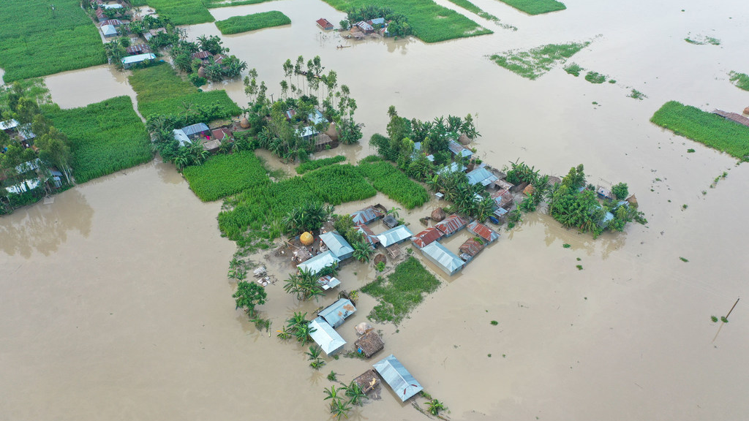
FloodAid Systems
A Flood Aid Decision-Support Platform
Bridging: Hydrology, Social Needs, and Humanitarian Logistics
Masrur Rahman Faraz
MITx MicroMasters, MBA (DU), BSc (MIST)
Supply Chain Experience in Electrical Projects
Photo Source: news.un.org/en/story/2025/08/1165615

Slide 2
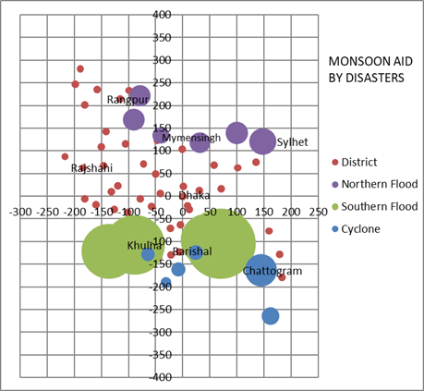
The Problem
More than 44 million people live in flood-risk districts in Bangladesh
Floods regularly disrupt:
  transport
  food access
  medicine supply
  local markets
Aid delivery is often:
  reactive
  fragmented
  delayed
Humanitarian agencies lack integrated systems that connect real-time disaster signals with operational logistics planning
In disasters, friction kills more than inefficiency

Slide 3
The Problem
Northern Flash Floods
  Rapid-onset isolation
  2-4 weeks disruption
  Cash assistance often effective
Southern Sustained Floods
  Long-duration waterlogging
  Aid demand may continue into 2nd month
  Domestic supply chains disrupt
Cyclone + Flood Coincidence
  Rare, but can be severe
  Port capacity disruptions
  Shelter & rehabilitation needs
Crisis = f (hazard, vulnerability)

Slide 4
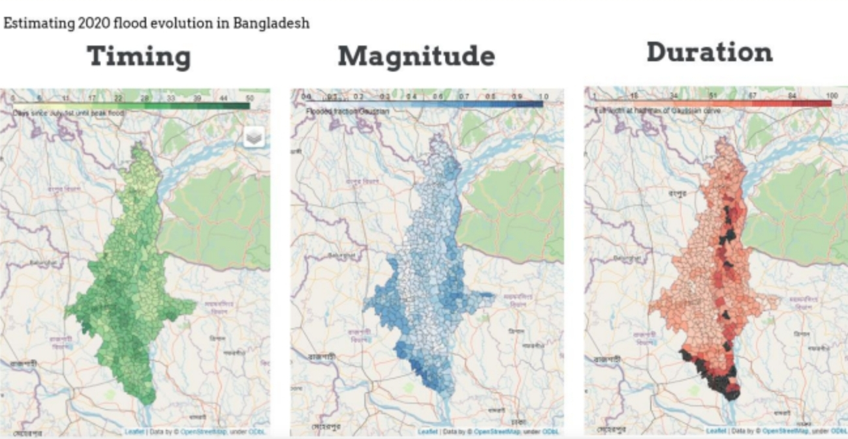
The Problem
Source: cerf.un.org/sites/default/files/resources/20-RR-BGD-44022_Bangladesh_CERF_Report.pdf

Slide 5
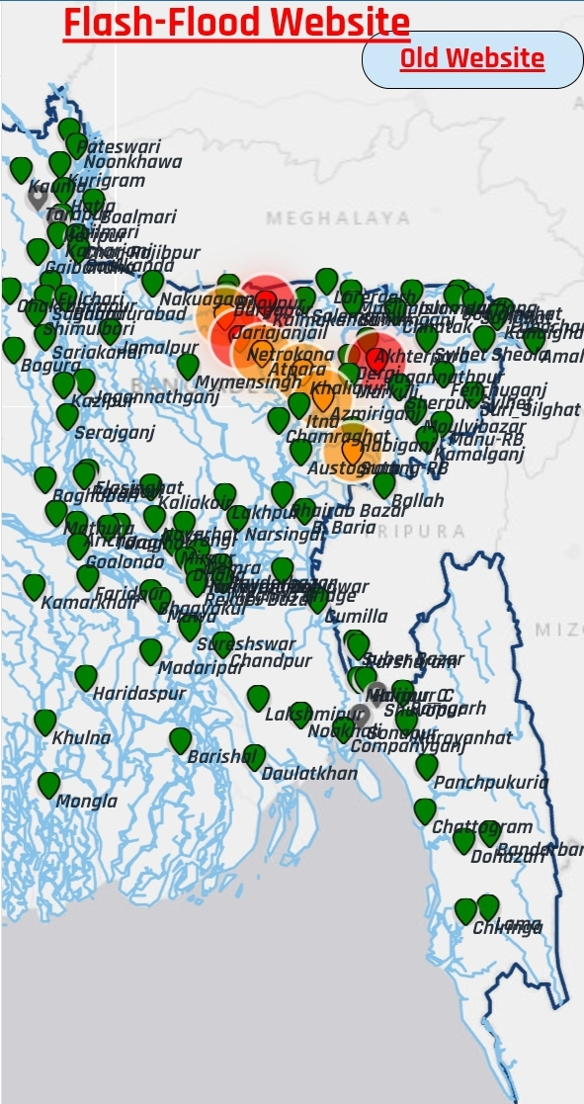
Proposed Solution
A Humanitarian Logistics Decision-Support Platform
Integrates:
  Real-Time Hydrology Data
    1 week Response Time
  Anticipate Social Needs
    Cash Assistance
    Physical Aid
    Rehabilitation
  Supply Chain Network Design, Market Intelligence & Visibility
  Community-level Distribution
    Micro-clustering of 1,000, 5,000 & 10,000 affected people
    Empower locals in final distribution to households
  Inter-organizational Operational Zoning
    If individual institutional clients waive privacy concerns
Source: ffwc.gov.bd/app/home (Date:11/05/2026)

Slide 6
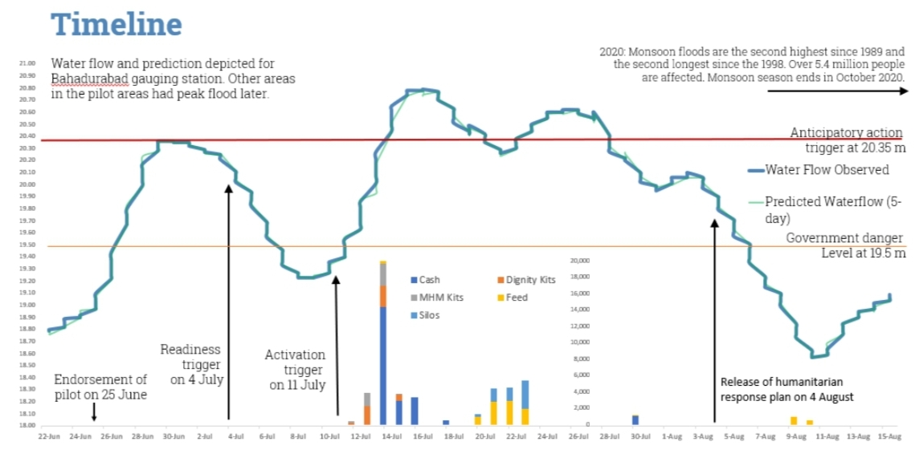
Proposed Solution
Source: cerf.un.org/sites/default/files/resources/20-RR-BGD-44022_Bangladesh_CERF_Report.pdf

Slide 7
Proposed Solution
Operational Model:
  Divisional Distribution Centers
    Cross-docks local purchased & imported aids
  District-Level Warehouses
    Strategically positioned for flood resilience
  Community-Level Coordination
    Micro-clustering of 1,000, 5,000 & 10,000 affected people
    Temporary operational hubs during disasters
    Local organizers support household handovers
  Flexible Response Modes
    Cash Assistance
    Physical Aid
      local procurement
      aid imports if markets fail

Slide 8
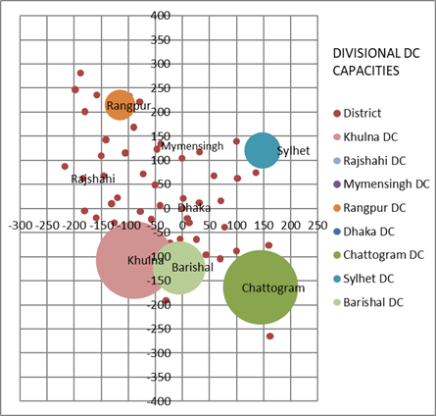
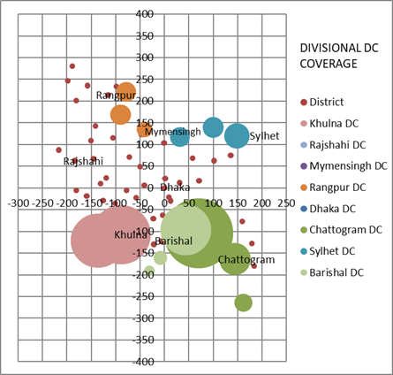
Proposed Solution

Slide 9
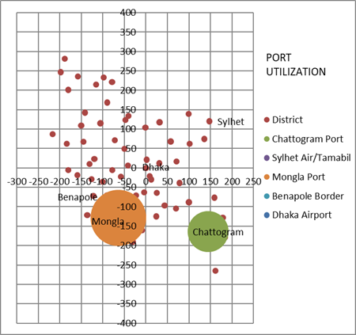
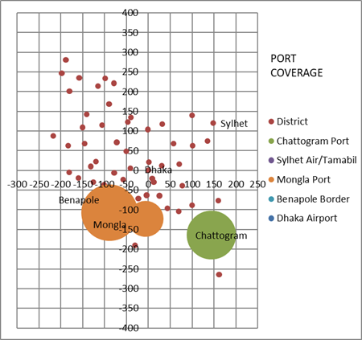
Proposed Solution

Slide 10
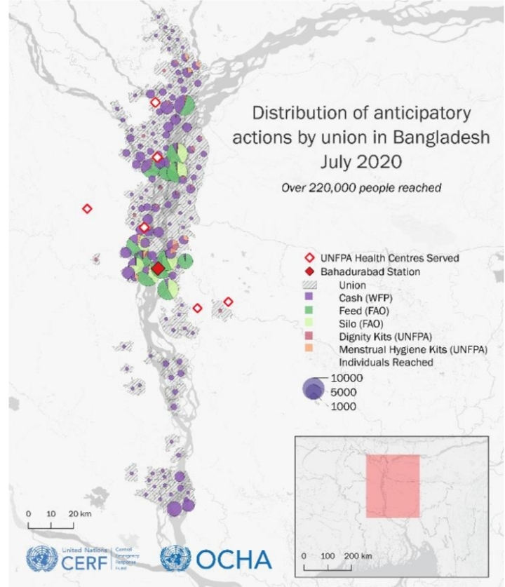
Proposed Solution
Source: cerf.un.org/sites/default/files/resources/20-RR-BGD-44022_Bangladesh_CERF_Report.pdf

Slide 11
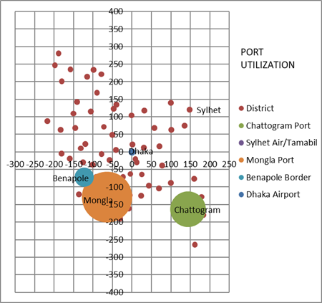
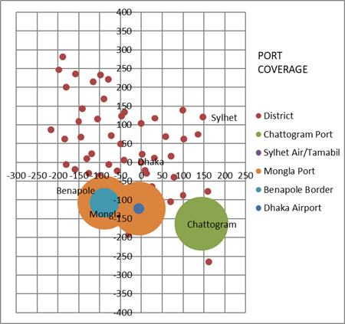
Proposed Solution

Slide 12
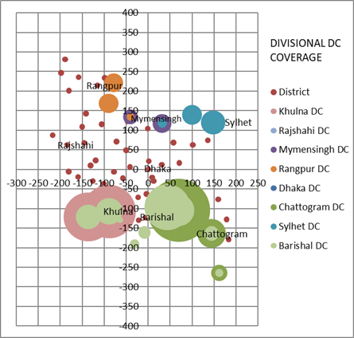
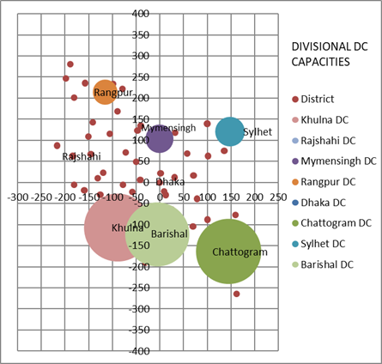
Proposed Solution
Source: cerf.un.org/sites/default/files/resources/20-RR-BGD-44022_Bangladesh_CERF_Report.pdf

Slide 13
Revenue Model & Financial Sustainability
Customers
  NGOs
  Government agencies
  UN organizations
  Humanitarian operators
Base Revenue Stream
  Software Roll-out Fees
    5 targeted institutional clients to cover R&D costs
  Annual Service Subscriptions
    5 targeted institutional clients to cover:
      Service personnel salaries &
      product improvement costs

Slide 14
Revenue Model & Financial Sustainability

Slide 15
Revenue Model & Financial Sustainability
Smaller local NGOs are given access at subsidized rates
Additional Profits to be reinvested in:
  Empowering local youths organizing final household distribution
    In partnership with NGOs operating locally
  Product improvement
Scale across:
  South Asia
  Southeast Asia
  Sub-Saharan Africa
  South America

Slide 16
Social Impact
Reducing Poverty:
  Timely delivery of right aid to affected population
    Saves them from potential 1 week starvation threats
  Stabilize domestic markets by:
    market intelligence &
    aid import recommendation
  Avoids over-serving & exclusion
    Through inter-organizational operational zoning
Reducing Unemployment:
  Empowers local youths in organizing final household distribution
    In partnership with operating NGOs
Reducing Emissions:
  Helping institutional clients in:
    Resilient Network Design Optimization, Scenario Planning & Simulations
    Operational Coordination via Micro-clustering, Visibility & Zoning

Slide 17
Questions?
Email: frazbd2@gmail.com
LinkedIn: linkedin.com/in/masrur-rahman-faraz-5a61068a/

